Slide 1


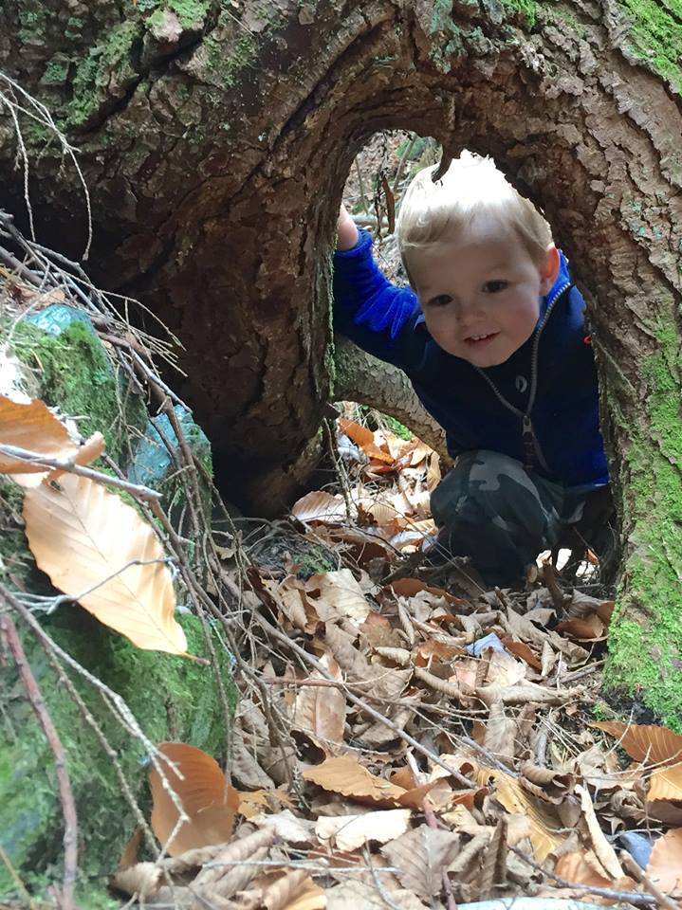
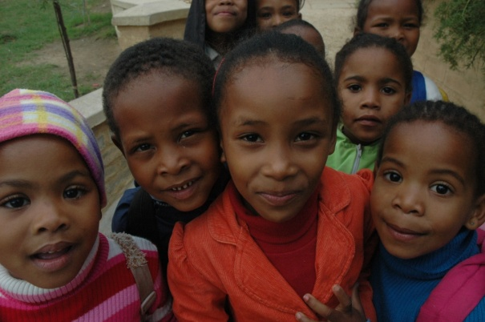
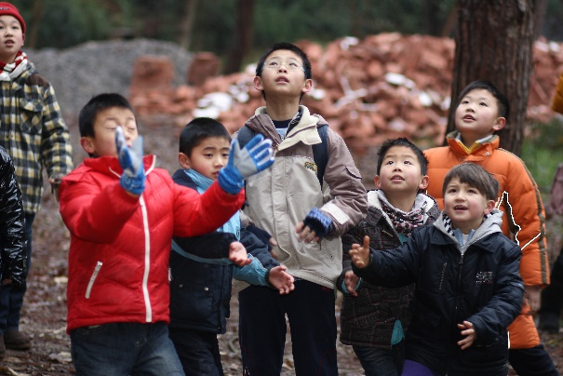
2015 Inspiring a New Generation Summit
A North American Initiative
November 6-8, 2015
Paul F-Brandwein Institute
Planning Meeting January 14, 2015
National Environmental Education Foundation,
4301 Connecticut Avenue NW, Suite 160, Washington, DC
summit@brandwein.org

Slide 2
Rationale for the 2015 Summit
Reunite People with Nature – especially young people
Over the last ten years, concerns have grown about humanity’s increasing disconnection from nature. From children with little opportunity to engage directly with nature; to people increasingly living in cities remote from the natural world; to young adults of the technology age for whom nature is seemingly irrelevant; to those communities most vulnerable to natural disasters; to poor people who struggle to live sustainably from nature’s bounty; and to a generation who want to help protect nature but feel disempowered. All these characterize a strained relationship with the natural world and have been the seeds of a worldwide movement to transform this situation.
Worldwide Movement Launched
The 2015 Summit will be convened in response to a call to action which was issued at the 2014 IUCN World Parks Congress in Sydney, Australia. During the 2014 Congress, thought leaders from around the world discussed the development of a global movement that connects new generations to nature and ensures a continuum of leadership and engagement through intergenerational partnerships.
Build call for Action across North America
One of the key legacy outcomes from the 2014 Congress was commitments by several nations to inspire the next generation of conservation leaders. The Paul F-Brandwein Institute, National Environmental Education Foundation (NEEF), State and Federal Public Land Agencies in the U.S. and Canada, and other leading North American organizations announce that they will collaborate to host an invitational 2015 Inspiring a New Generation (ING) Summit to expand this global call to action throughout North America.
Brandwein Institute
summit@brandwein.org

Slide 3
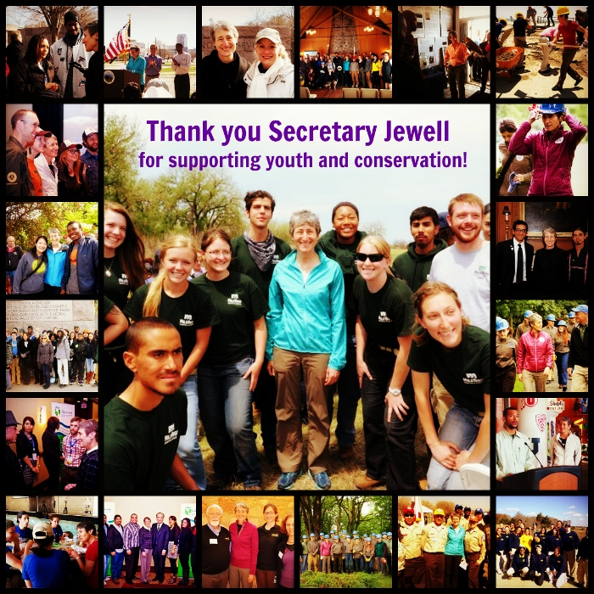
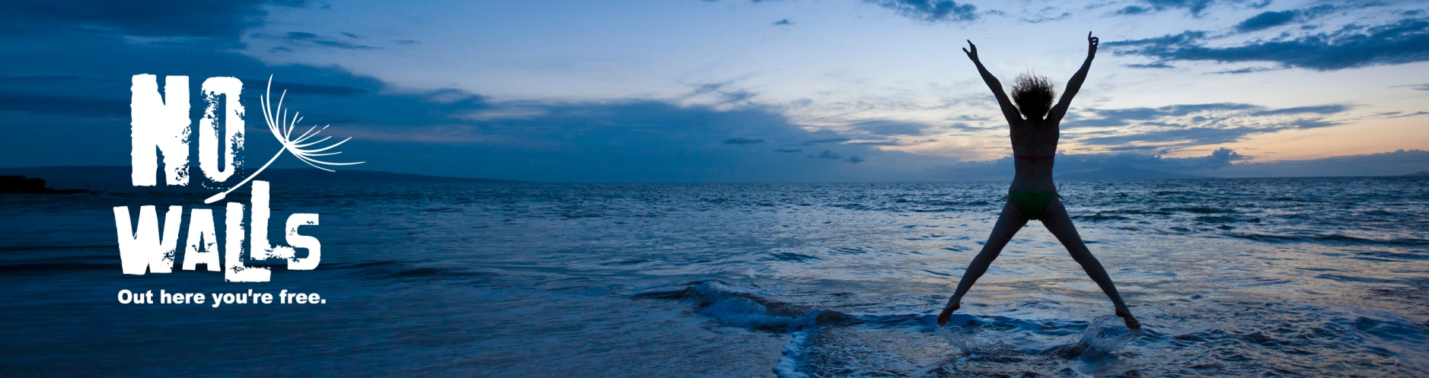
Leverage Existing Initiatives
U.S. Secretary of Interior Sally Jewell’s Executive Order (2014) - Connect Millions of Young People to America’s Great Outdoors is focused on a national youth initiative to inspire millions of young people to play, learn, serve, and work in the outdoors
No Walls - a global initiative led by youth, for youth to inspire connections with nature, catalyzed by Parks Canada and launched at the 2014 World Parks Congress.
Brandwein Institute
summit@brandwein.org

Slide 4
Legacy Commitment for 2015 ING Summit
Cheryl Charles and Marily DeWall, Brandwein Institute Directors delivered a World Park’s Congress legacy commitment on behalf of the sponsors of the 2015 Inspiring a New Generation Summit on Nov 18, 2014.
Brandwein Institute
summit@brandwein.org

Slide 5
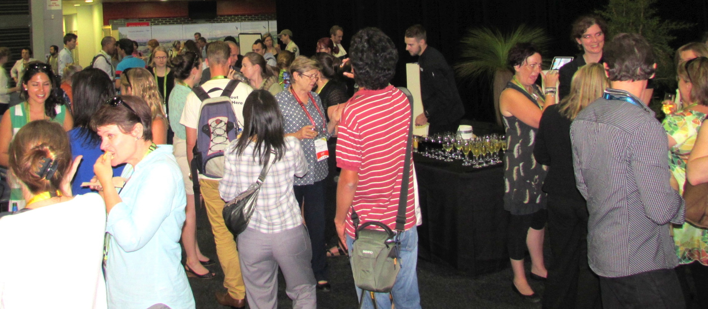
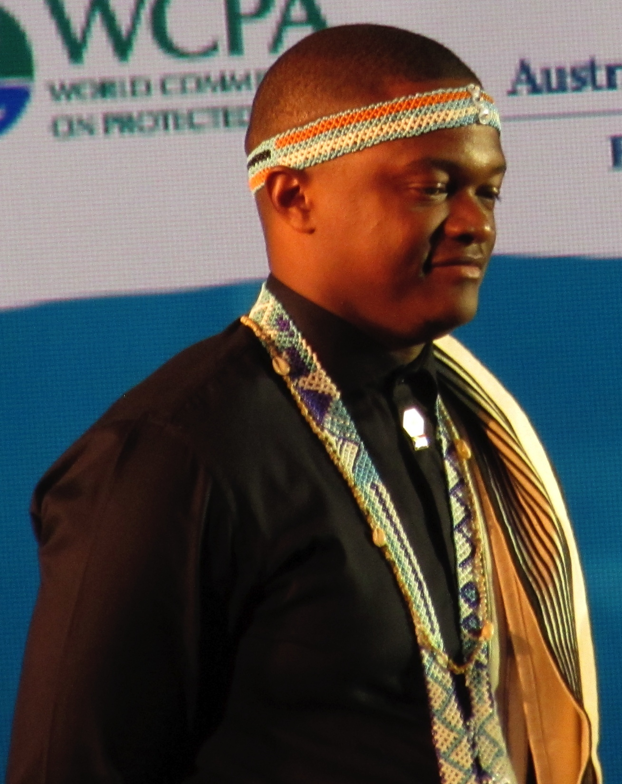
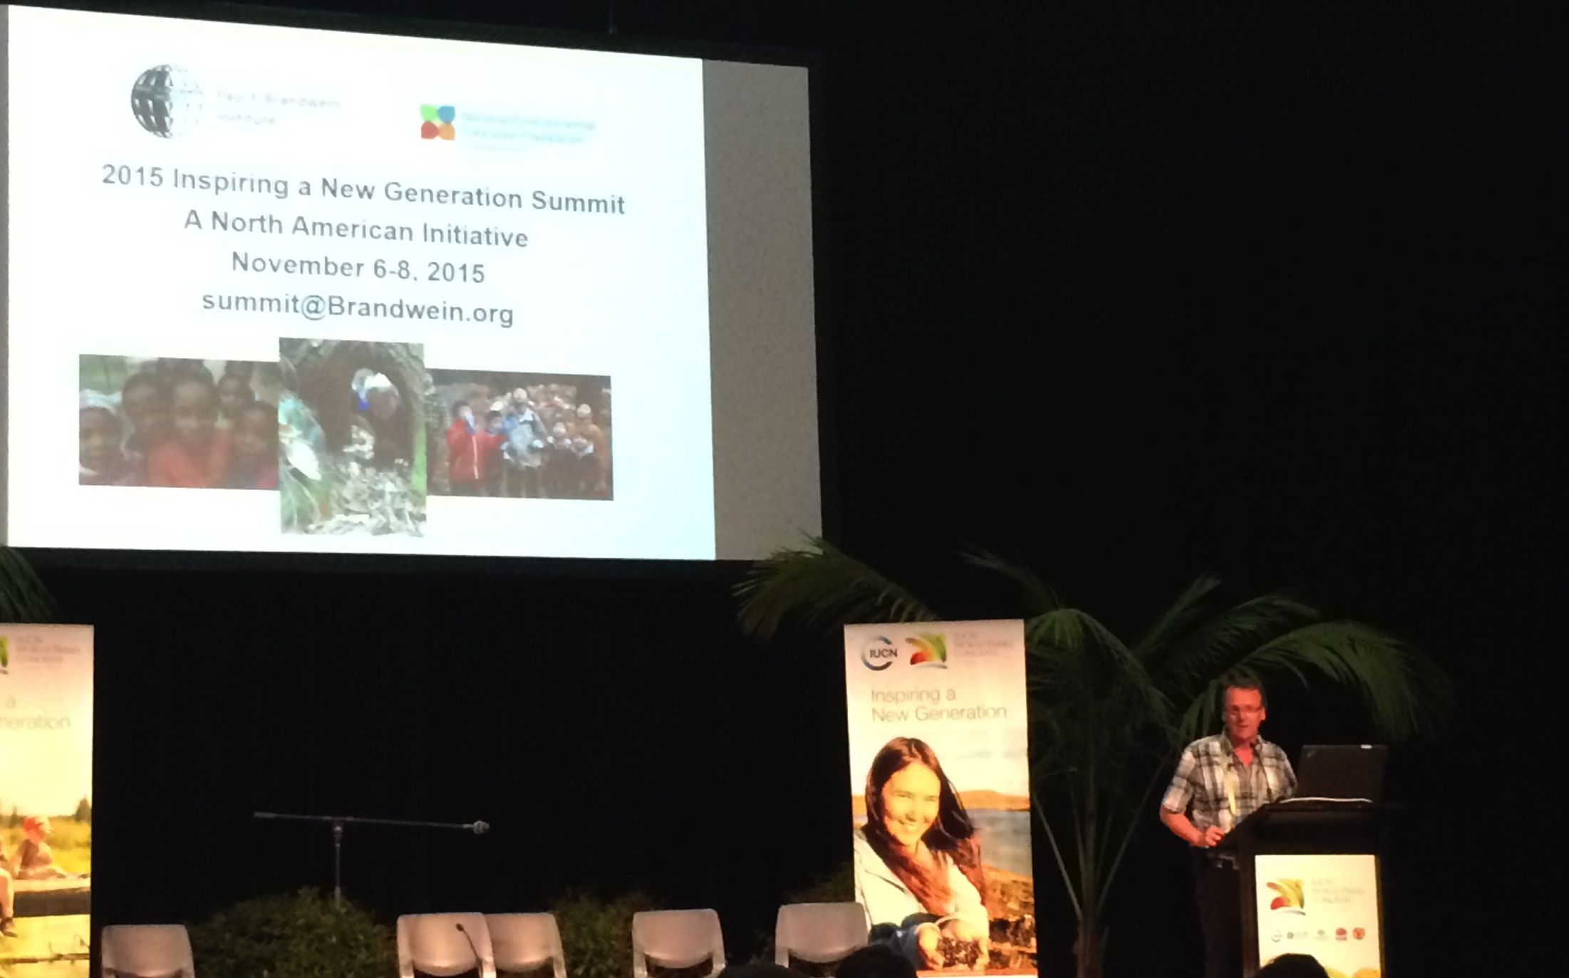
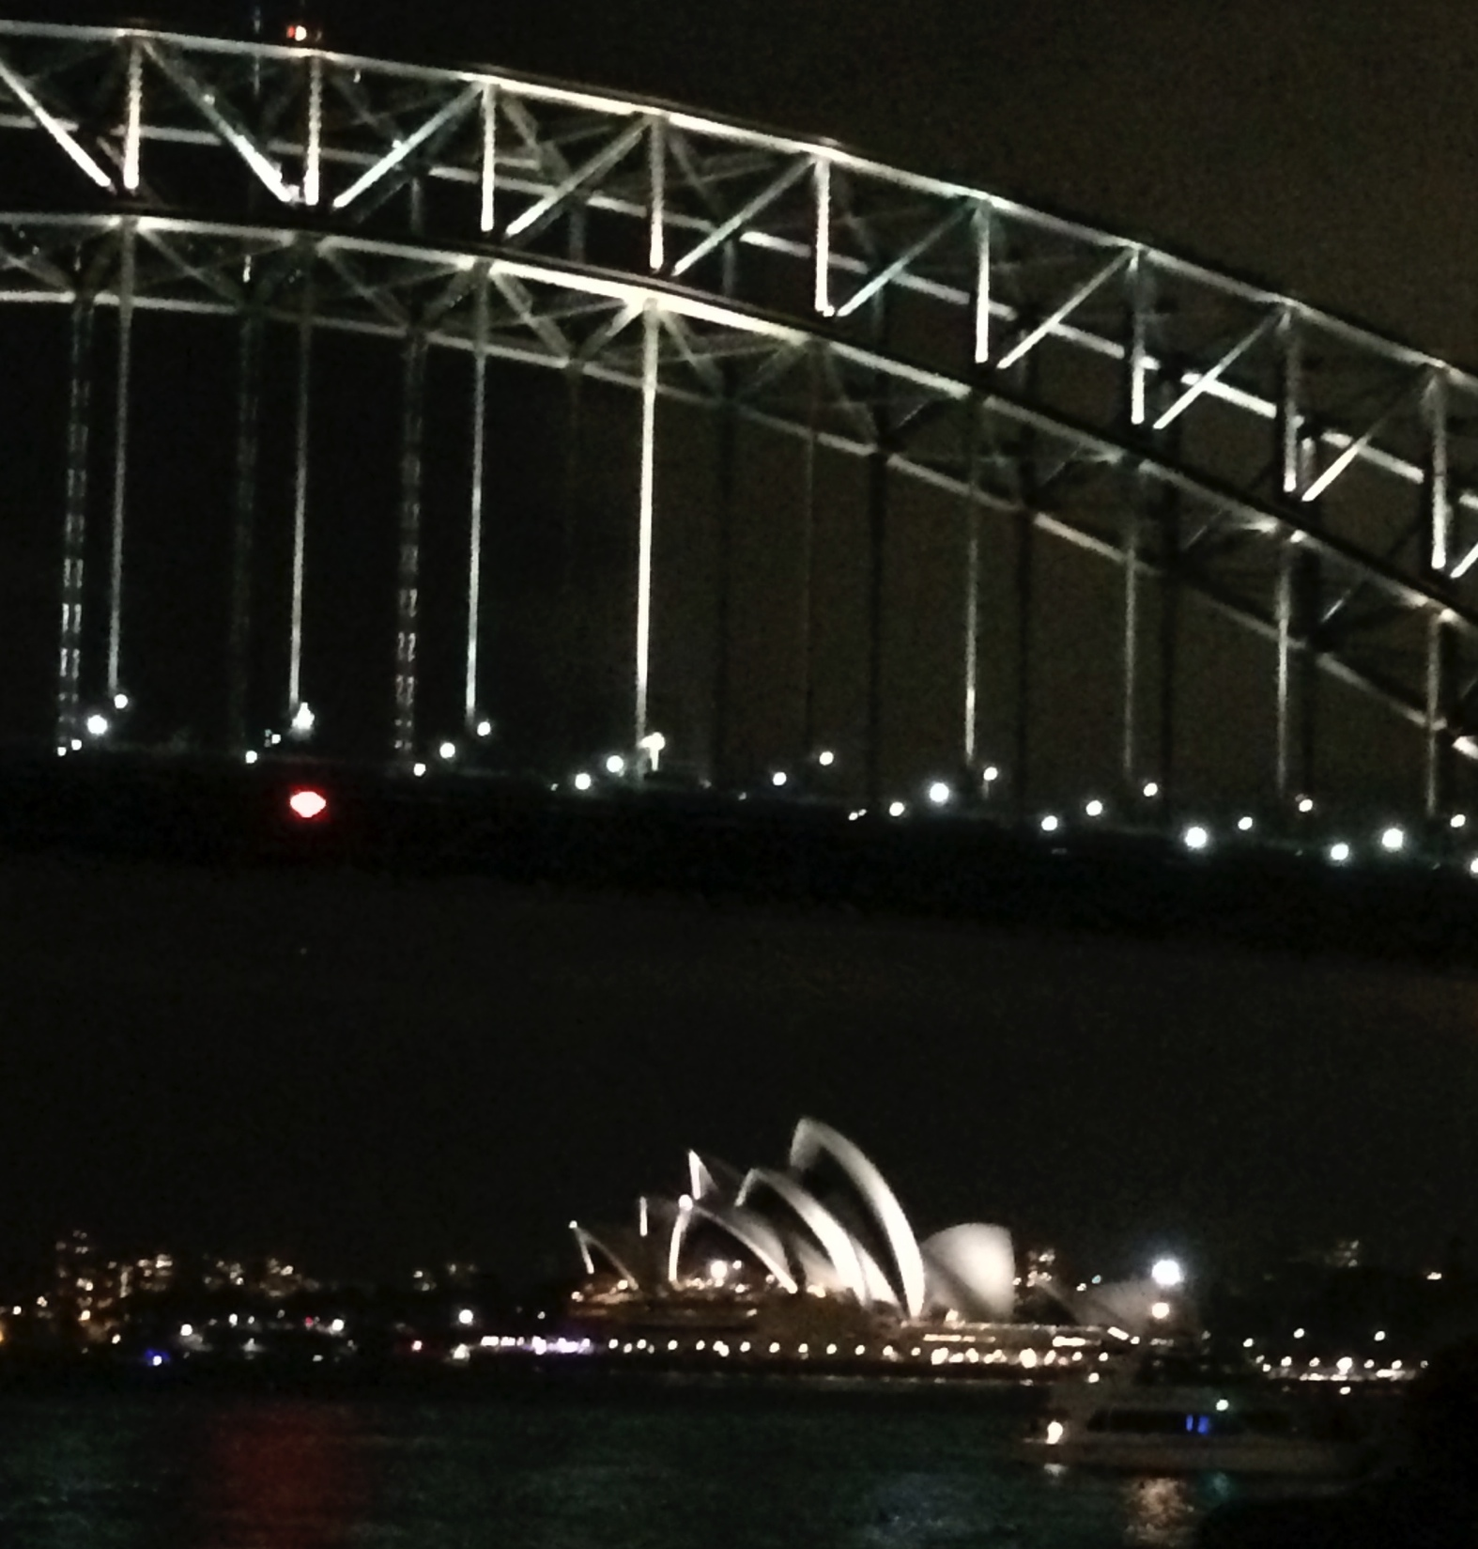
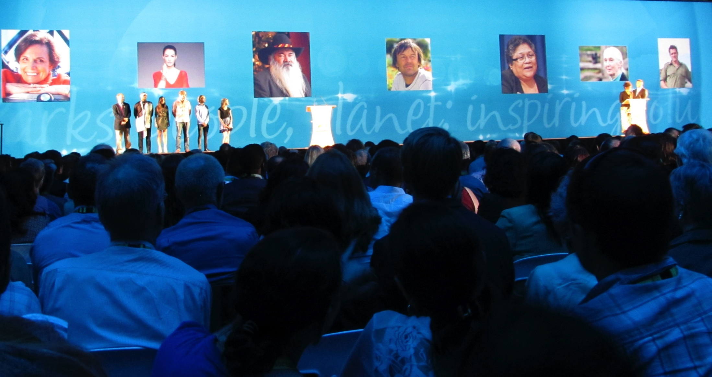

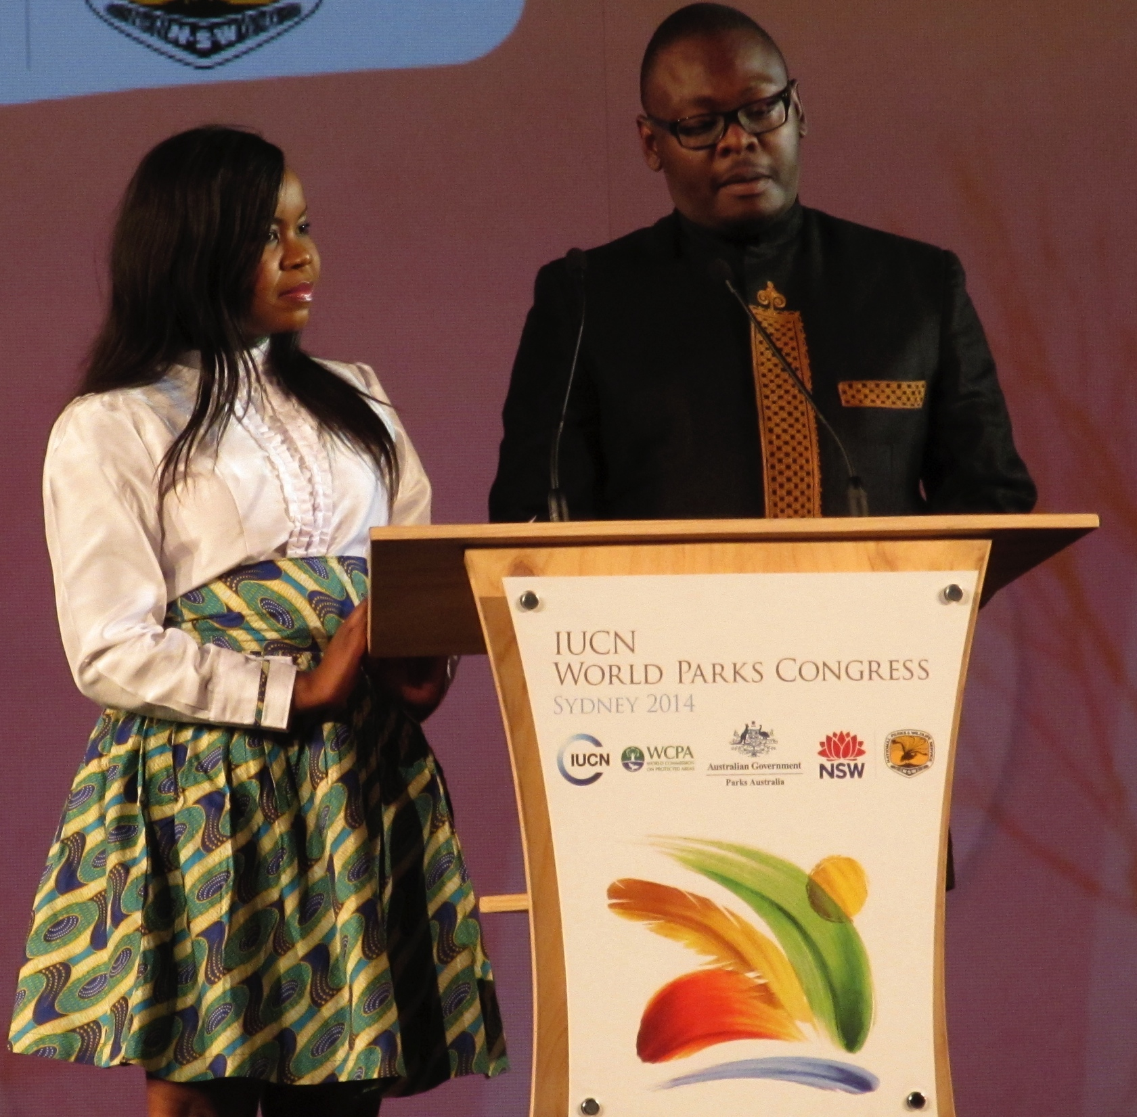
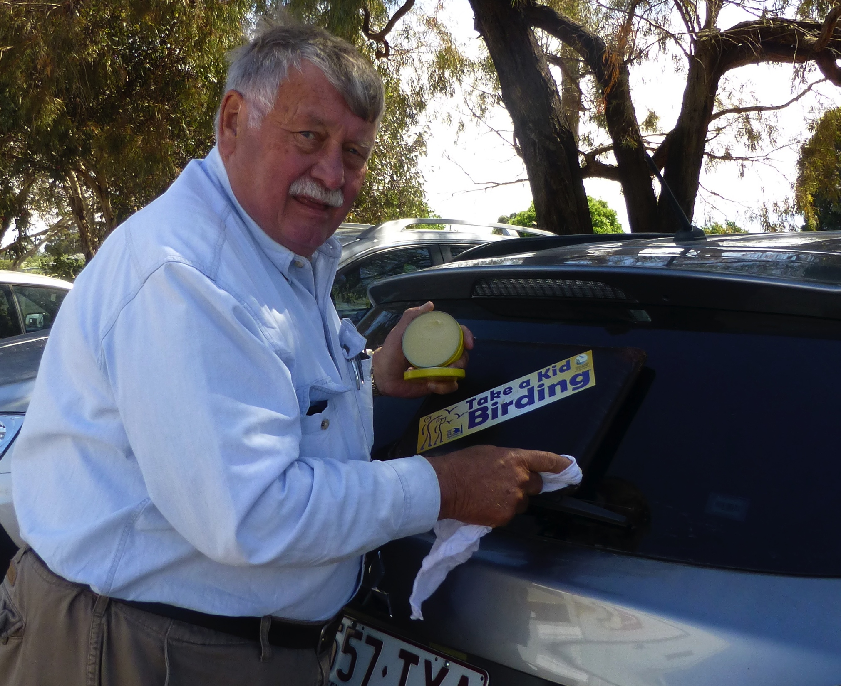
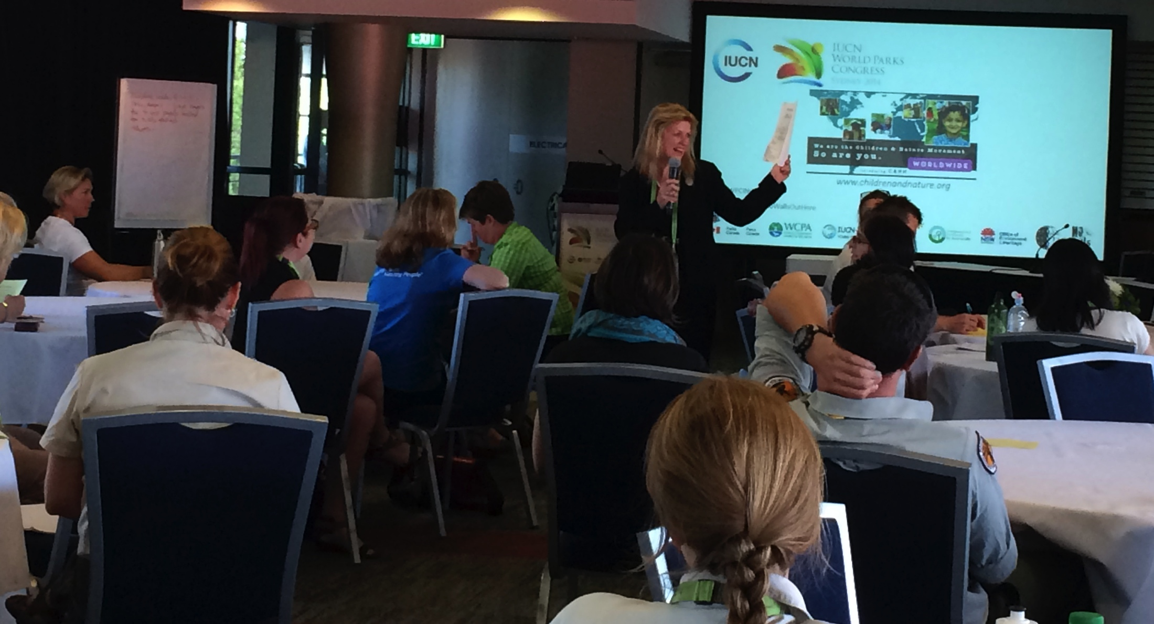

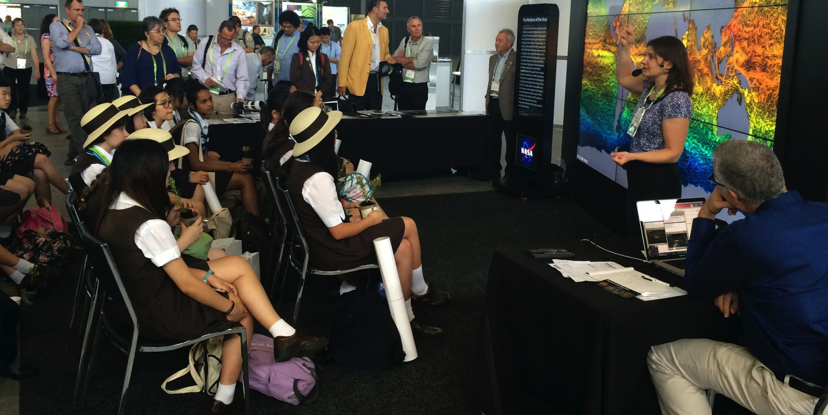
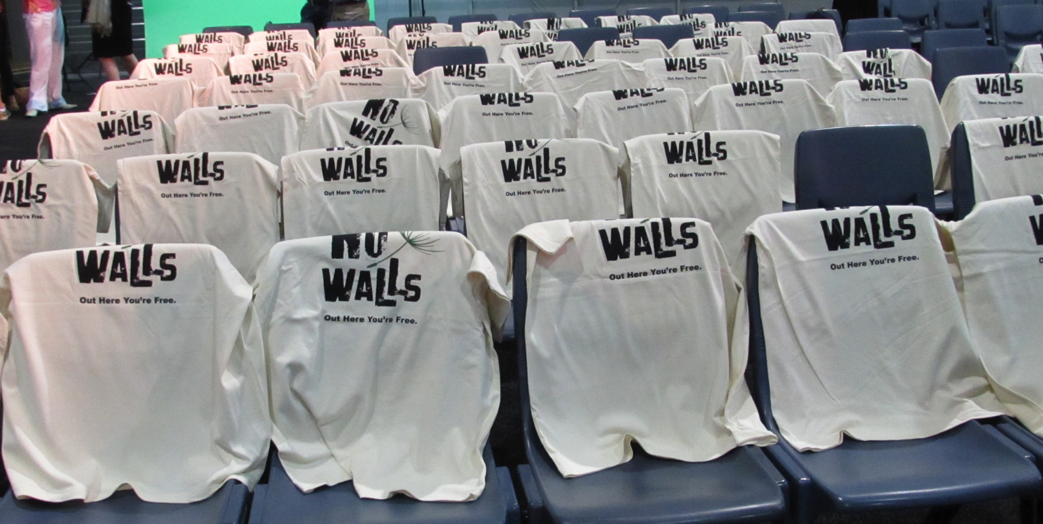
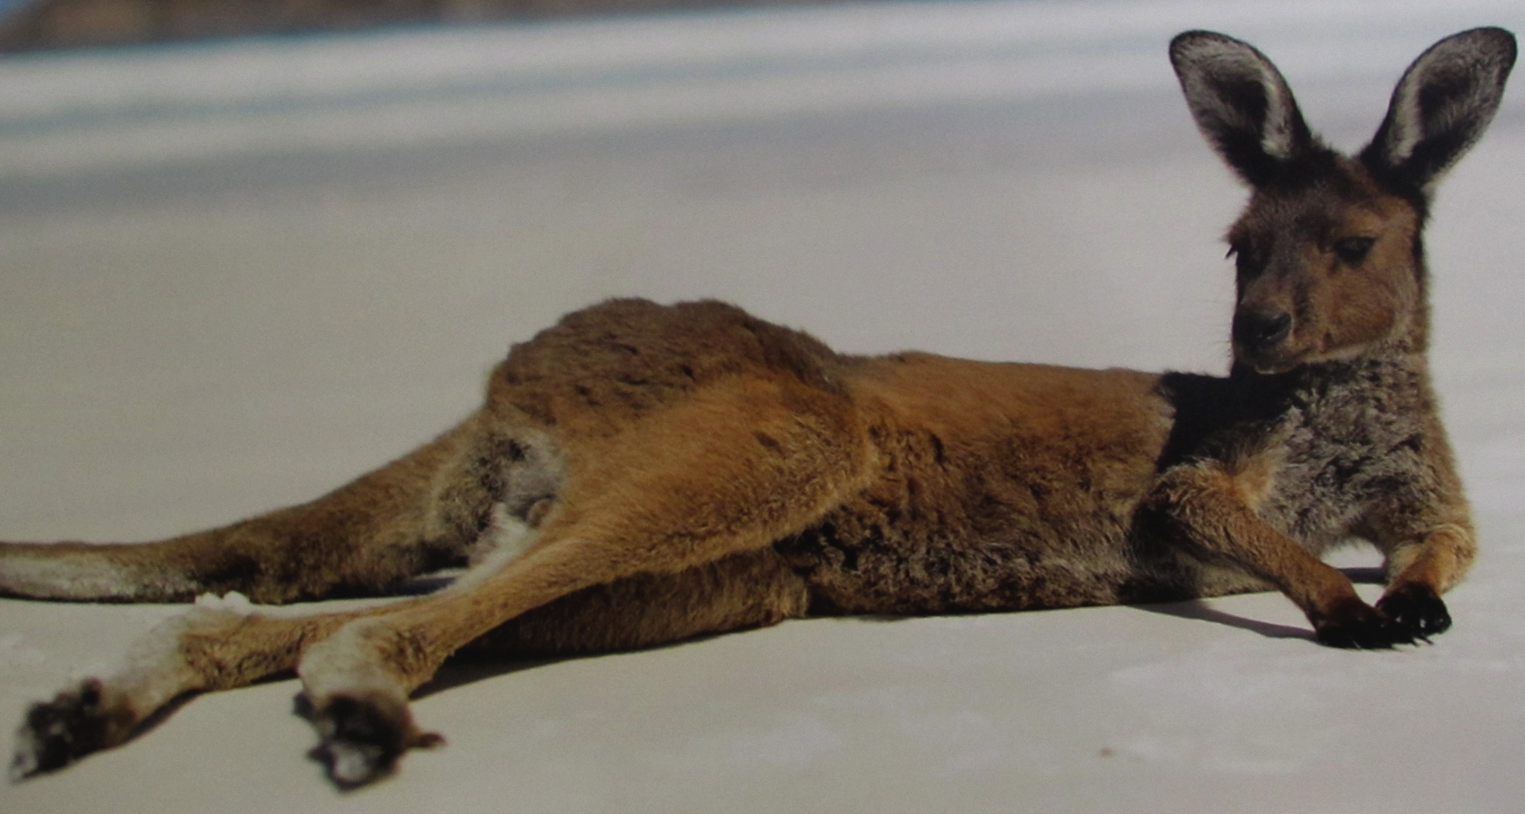
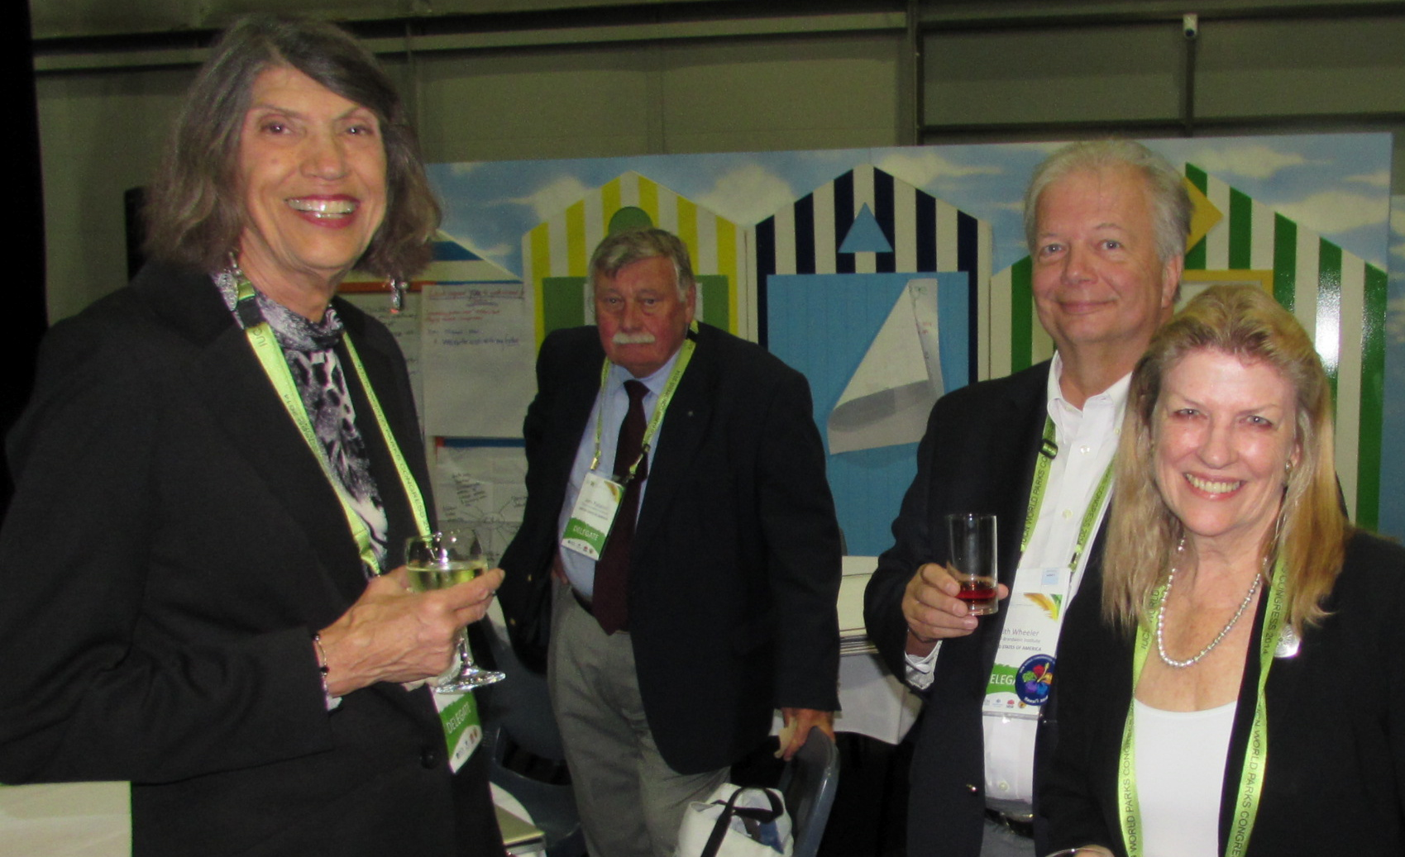

Slide 6
Draft Vision for 2015 ING Summit
Vision
Inspiring the New Generation is a new 21st century nature movement designed to promote understanding and appreciation for the science of nature, the intrinsic and extrinsic value of nature, the spiritual dimensions and beauty of nature, and the critical need to conserve nature. The movement builds on the shoulders of the great nature visionaries of the late 19th and 20th century, rekindling a legacy of building life-long relationships with nature for current and future generations.
Goal
To catalyze support for a movement dedicated to engage people, particularly young people, across North America and the world to experience, understand, value, and conserve nature.
Key Objectives
Convene key North American stakeholders to embrace the Inspiring the Next Generation movement.
Develop a North American Action Agenda that defines and illustrates the opportunities for various stakeholders to contribute to this new movement and communicate the agenda to a wide audience.
Build on the No Walls Initiative that invites new audiences to connect to nature by highlighting examples of myriad recreational and inspirational venues nature provides.
Build capacity and share innovative best practices in connecting people with nature, including engaging new partners and sectors of society that have been underrepresented in nature conservation fields. A special emphasis will relate to barriers to be overcome and motivators to build lasting connections with people to nature.
Engage young people from around the world to share knowledge, experiences and perspectives, build capacity, take leadership, and inspire others to connect with nature through international and intergenerational partnerships.
Brandwein Institute
summit@brandwein.org

Slide 7
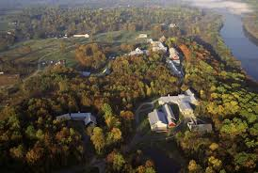
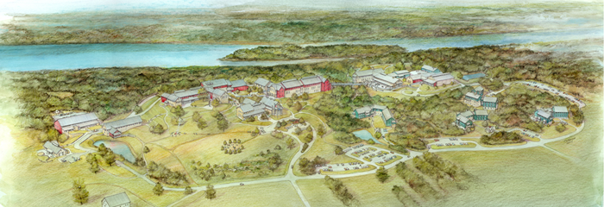
Logistics
Nov. 6-8, 2015
National Conservation Training Center – Shepherdstown, WV
225 Participants - Invited guests (Invitational Only)
Minimum 40 invitees under age of 35
Summit organizers will cover all facility, lodging and meal costs. Participants cover their own transportation costs.
North American focus
Facilitated Process
Moderated - Town Hall Meeting Style Plenaries
Work groups to develop a North American Action Plan
Video and Publication Products
Press multi-media post event gathering at World Conservation Congress at Hawaii Convention Center in Honolulu from Sept. 1 to 10, 2016
Brandwein Institute
summit@brandwein.org

Slide 8
Proposed Planning Meeting Schedule
Executive Steering Committee Meetings will be hosted by National Environmental Education Foundation at 4301 Connecticut Avenue NW, Suite 160, Washington, DC
  January 14, 2015
  March 17, 2015
  May 12, 2015
  July 14, 2015
  September 15, 2015
  Nov 6-8, 2015 (Event)
Working Committee meetings via email, skype and phone between steering committee meetings
Brandwein Institute
summit@brandwein.org

Slide 9
Draft Invitation Selection Process
225 Participants Total at NCTC
At least 30% Young Professionals Ages 20-35
Agency Representation
NGO Representation
Foundation Representation
Participants from Canada
Private Sector Representation
Academic Representation
Government
Representation
Participants from Mexico
K-12 Education
Representation
Outdoor Education
Representation
Outdoor Sports
Representation
Mix of the 12 Categories
Public Health
Representation
Social Media
Representation
Communication
Representation
Brandwein Institute
summit@brandwein.org

Slide 10
Draft Agenda ver.1.5
Friday Nov 6, 2015 PM
Arrive - Registration – Settle in 3:00-5:00
5:00PM Reception and Dinner
Key Note Speaker & Set the Stage for the Summit
Youth Voice
Saturday Nov 7, 2015 AM
Morning Session – Key Note - TBD
Town Hall Type Panel 4-5 High Profile People (Sub -Topic TBD)Moderated by High Profile Person
Break Out Sessions around Driving Question
Break
Town Hall Type Panel Panel 4-5 High Profile People (Sub -Topic TBD) Moderated by High Profile Person
Lunch
Saturday Nov 7, 2015 PM
Afternoon Session – Key Note - TBD
Break Out Sessions around Driving Question
Key Note - TBD
Exhibit Hall Reception and Conversation with Best in Class Programs
Dinner
Key Note - TBD
Sunday Nov 8, 2015 AM
Morning Session – Report Out – Key Note - TBD
Opportunities to Commit
Town Hall Type Panel 4-5 High Profile People (Report Out on Summit) Moderated by High Profile Person
Commitment Sessions – What is my Organization ready to commit too?
Thanks for Participating
Depart by 11:30 AM
Brandwein Institute
summit@brandwein.org

Slide 11
Draft Budget to Date
Item Estimated Amount
  Lodging and Meals for 225 Participants at National Conservation Training Center, Shepherdstown WV (2015) $ 110,000.00
  Airport Transportation from Dulles Airport to venue for participants $ 5,000.00
  Receptions $10,000
  Facilitation Team $ 25,000.00
  Video / Audio event capture $ 20,000.00
  Proceedings - publication $ 20,000.00
  Editorial Team $ 15,000.00
  Planning Meeting Travel $ 7,500.00
  WCC Findings release event (2016) $25,000.00
  Web and Social Media Management $10,000.00
  External Communications$ 25,000.00
Approximately $ 272,500.00
Amount Committed (As of July 15, 2014)
  Paul F-Brandwein Institute $ 100,000.00
  National Environmental Education Foundation $ 15,000.00 (minimum)
Total $ 115,000.00
Draft Sponsorship Packages
Diamond $50K
Platinum $25K
Gold $15K
Silver $10K
Bronze $5K
Brandwein Institute
summit@brandwein.org

